Slide 1

Developing Your LLM Intuition
André Anan Gilbert
May 30, 2024

Slide 2
Agenda
What is an LLM doing?
LLMs need Tools
LLM-powered AI Agents
Q & A

Slide 3



What is an LLM doing?
Algorithmic reasoning
A process that yields the same output given the same input
No ambiguity
LLMs occupy a middle ground
Are fluent in natural language, yet they don’t really understand what they say
Are bad at executing algorithms, yet they can be instructed to execute the appropiate algorithms
Human thought
Is inherently creative as thought differs from human to human
Ambiguity

Slide 4
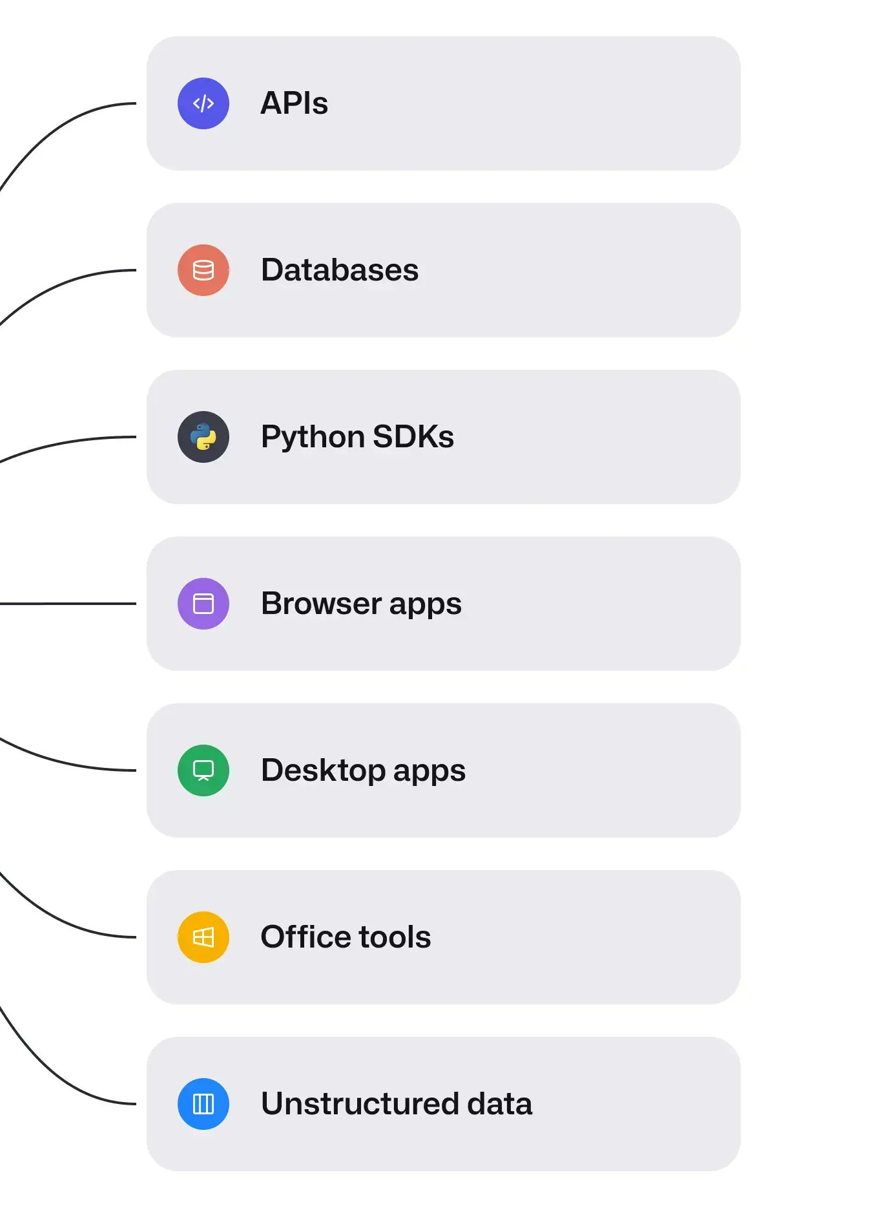
LLMs need Tools
Tools
Allow LLMs to pursue specific, scoped goals
Enable automation of repetitive tasks
Include APIs, SDKs, or specialized tools for tasks challenging for LLMs (math, current date)
Governed tool access
Tools should have a tiered access level
Tool can be executed
Tool needs approval before execution
Tool can only be suggested

Slide 5

LLM-powered AI Agents

Slide 6


Q & A

Slide 7
Thank you.
André Anan Gilbert
Email

Slide 8
Developing Your LLM Intuition
André Anan Gilbert
Jun 06, 2024

Slide 9
Agenda
Retrieval Augmented Generation
Fine-Tuning LLMs
Q & A

Slide 10
Retrieval Augmented Generation

Slide 11
Fine-Tuning LLMs
Quantization
Content
Content
LoRA
Content
content

Slide 12
Q & A

Slide 13
Thank you.
André Anan Gilbert
Email

